Slide 1
C PROGRAMMING
DAY 7
EDUCATION OUTREACH PROGRAM

Slide 2
MEMORY MANAGEMENT
Why we need to do dynamic memory allocation ?
int x[100] ; x[0] =5; // rest 99 blocks are wasted
The C programming language provides several functions for memory allocation and management.
These functions are defined in <stdlib.h> header file.
Let’s discuss some of these functions.

Slide 3
malloc( )
syntax :- void* malloc(size)
It returns a void pointer after creating a memory block of given size.
We need to typecast void* to desired pointer type like int* so that we can use it correctly.
eg :- int *p;
p= (int*) malloc (sizeof(int) * 5);
This will create a memory block of size = size of 5 int , and will assign the pointer p to it.
If no memory is left to assign then it will return NULL.
2000
p
2000
2002
2004
2006
2008
2010

Slide 4
calloc( )
syntax :- void* calloc(number of elements , size of each element)
calloc initializes the allocated space with 0.
We need to typecast void* to desired point type like int* so that we can use it correctly.
eg :- int *p;
p= (int*) calloc ( 5, sizeof(int));
This will create a memory block of size = size of 5 int , initialize them with 0 and will assign the pointer i to it.
2000
0
0
0
0
0
p
2000
2002
2004
2006
2008
2010

Slide 5
realloc( )
syntax :- void* realloc(void *ptr , size of new block)
calloc initializes the allocated space with 0.
We need to typecast void* to desired point type like int* so that we can use it correctly.
eg :- p= (int*) realloc ( p, 10);
This will create a memory block of size = size of 10 int , and will assign the pointer p to it.

Slide 6
2000
1
2
3
4
5
p
2000
2002
2004
2006
2008
2010
p= (int*) realloc ( p, 10);
3000
1
2
3
4
5
p
3000
3002
3004
3006
3008
3010
3012
3014
3016
3018
3030
P stops pointing to blocks stored at 2000 and starts pointing to newly created blocks stored at 3000

Slide 7
free( )
It is used to free the dynamic allocated memory.
syntax :- void* free(void *ptr)
It is important to free the memory so that other variables can use it.
eg :-
p= (int*) malloc ( 10 *sizeof(int) );
free(p);
This will free the memory block which is pointed by p.

Slide 8
MEMORY LEAK PROBLEM
We cannot use p in main block because scope of p is within fun block only.
If it is not needed in main function then we should always free it.
If we create a dynamic memory but we cannot access it then it is called memory leak problem.
void fun() { p= (int*) malloc ( 10*sizeof(int) ); }
int main() {
void fun();
}

Slide 9
STRUCTURE
Array : collection of similar items.
Structure : collection of non-homogenous items
eg :- Student has a name,rno, marks
So student here is an structure and name, roll no, marks are his attributes
name
rno
marks
student

Slide 10
struct student {
char name[100];
int rno;
float marks;
};
int main() {
struct student s1,s2,s3;
struct student s[100];
}
name
rno
marks
student

Slide 11
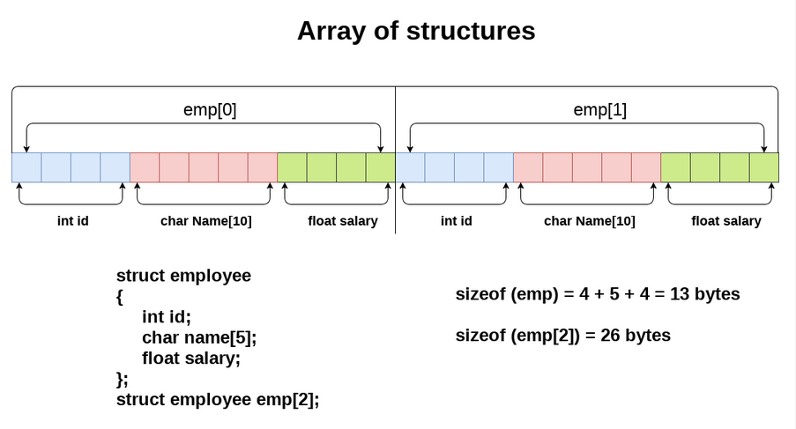

Slide 12
SELF REFERENTIAL STRUCTURE
struct node
{
int data;
struct node *next;
};
data
next
node

Slide 13
APPLICATION OF STRUCTURES
HEAD
data
next
data
next
data
next
node
node
node
NULL

Slide 14
LINKED LIST :- collection of nodes that are connected with help of pointers.
STACK :- If we insert and delete on only one end then it is called stack, LIFO
QUEUE :- If we insert on one end(front) and insert at other end (rear) then it is called Queue, FIFO.

